Slide 1
Research Methods
Vinit Kumar

Slide 2
What’s the Difference Between Methodology and Methods?
A method is a way of doing research, such as survey research, ethnography, documentary research, or qualitative interviews. Methods are the techniques or procedures used to gather and analyze data related to a research question or hypothesis.
A methodology is the philosophical position which underpins our understanding of what we are doing when we generate knowledge about the world. Methodology is the strategy, or design, lying behind the choice and use of particular methods and links the choice and use of methods to desired research outcomes. Methodology is related to epistemology and ontology, and all of these concepts are sometimes referred to together as the philosophy of research or the philosophy of methods.

Slide 3
Scientific method
It relies on empirical evidence;
It utilizes relevant concepts;
It is committed to only objective considerations;
It presupposes ethical neutrality, i.e., it aims at nothing but making only adequate and correct statements about population objects;
It results into probabilistic predictions;
Its methodology is made known to all concerned for critical scrutiny are for use in testing the conclusions through replication;
It aims at formulating most general axioms or what can be termed as scientific theories.

Slide 4
The scientific method encourages a rigorous, impersonal mode of procedure dictated by the demands of logic and objective procedure

Slide 5
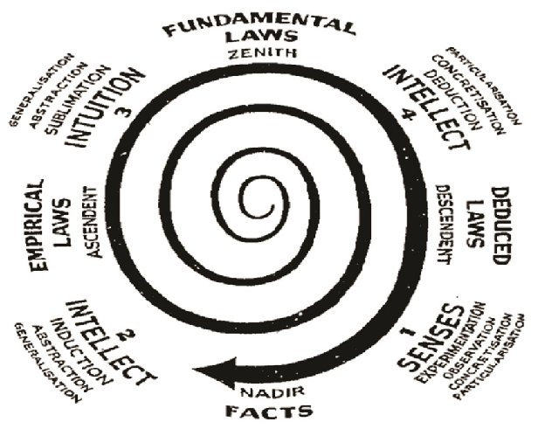
Spiral of Scientific method
By Dr. S.R. Ranganathan
Five laws of library science (1957)
Three processes
Observation of facts
Visual
With suitable instrument
Experiment
Formulation of hypothesis
Verification of hypothesis

Slide 6
Logic
Inductive logic
Particular to general
One crow is black
Many more crows are black
All crows are black
Deductive logic
General to particular
Men are mortal
Ram is a man
Ram is mortal

Slide 7
Spiral of Scientific method
Four Quadrants
Quadrant 1
Quadrant 2
Quadrant 3
Quadrant 4

Slide 8
Quadrant 1
Descendant to Nadir
Use of primary senses to accumulate data
Facts are recorded
Progress towards concreteness and regression towards abstractness
Progress towards particularisation and regression from generalisation

Slide 9
Quadrant 2
Nadir to Ascendent
Use of intellect
Reasoning with the help of inductive logic
Boiling down of the numerous facts at nadir to induced or empirical laws to the few fundamental laws
Progression towards ultimate generalisations/abstractness and regression from particularisation
Progression towards abstractness and regression from concreteness.
Induced or empirical laws are formulated

Slide 10
Quadrant 3
Ascendent to Zenith
Use of intuition
Boiling down of the induced or empirical laws to the few fundamental laws
Progression towards ultimate generalisations/abstractness and regression from particularisation
Regression from concreteness and progression towards abstractness.
Fundamental laws are recorded

Slide 11
Quadrant 4
Zenith to Descendent
Use of intellect
Reasoning with the help of deductive logic
Progression towards particularisation and regression from generalisation
Progression towards concreteness and regression from abstractness
Deduced laws are derived
Deduced laws include one or all induced laws
The number of deduced laws exceeds that of empirical laws.

Slide 12
Observation corresponds to Quadrant 4 and 2
Formation of hypothesis corresponds to Quadrant 3
Whereas, the testing of hypothesis to the Quadrant 4
Any domain in the universe of knowledge which admits of this spiral in the course of its development is a ‘Science’.

Slide 13
Entrance into next cycle
Two things happen at the quadrant 1
Observation and experiments are made to verify empirically the validity of deduced laws; and
Further observation and experiments are made continuously and this leads to accumulation of new empirical laws.

